Slide 1
Predictive analytics
Data wrangling to create a time series
Time series analysis
Time series visualization
Time series prediction

Slide 2
Ex 3: Class walk through
Read carbon emissions
carbon-1651-present.csv
Discard before 1958
Create a new column, timestamp, of the form
year-7-1 00:00:00
Mutate (Create Calculation) > paste(year,’-7-1 00:00:00’)
Convert character string to timestamp
Change Data Type to year, month, day, hour, minute, second

Slide 3
Ex 3: Class walk through (cont)
Create forecast
Run Analytics > Run Time Series Forecast
Aggregate to year
Forecast CO₂
Plot year by forecast and actual
What do you conclude about the accuracy of the forecast and its meaning?

Slide 4
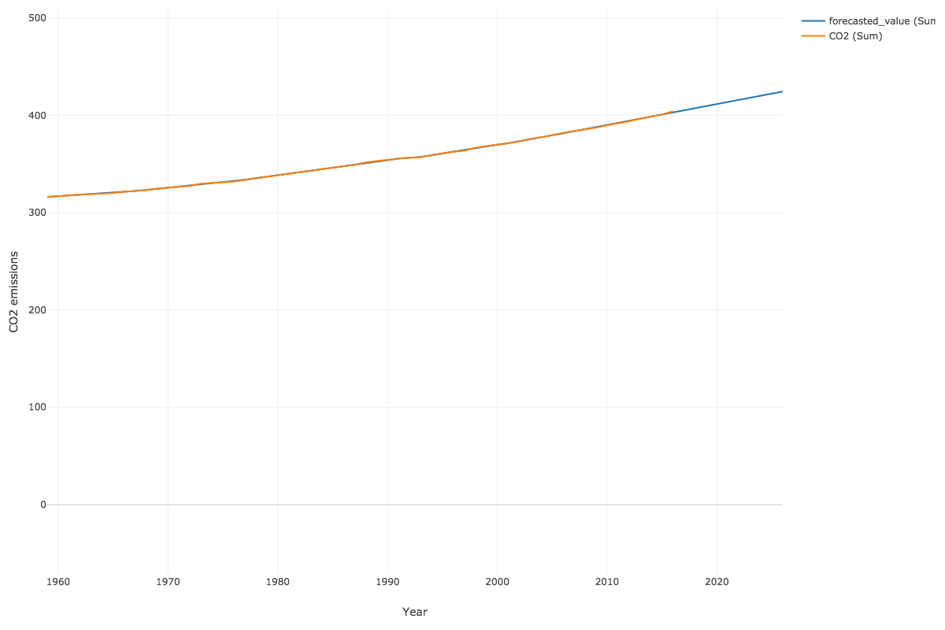

Slide 5
Class assignment #3

Slide 6
Load a bit over a year’s worth of retail data for a EU online store
OnlineRetail.csv
Compute the revenue of each sale
Forecast total weekly revenue for the next 10 weeks
Should you consider seasonality?
Create a visualization showing actual and trend

Slide 7
Submission – Publish your tables and charts on Exploratory. Screenshot the images and upload 1 Word file with the names of the 2 people who worked on it. Turn in the following
Forecast for the next 10 weeks
Visualization showing actual and trend

Slide 8
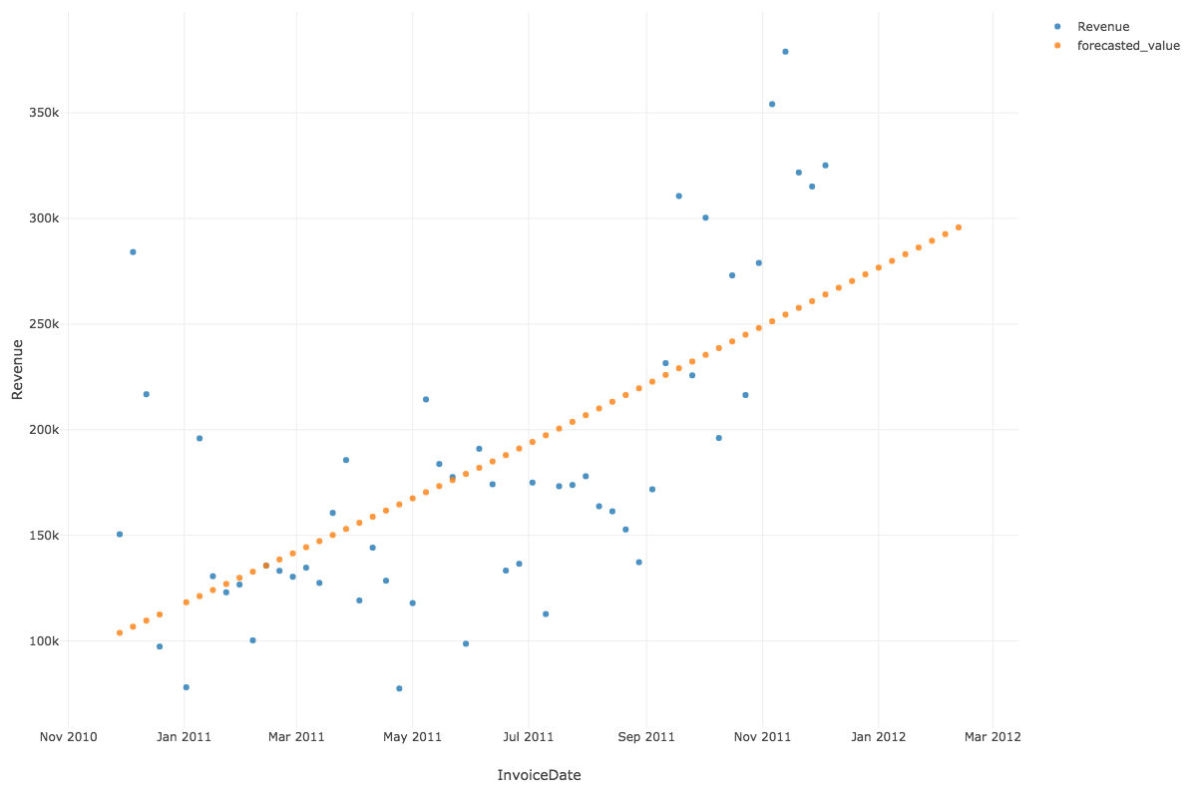
Weekly sales forecast

Slide 9
Prescriptive analytics
Read from a database
Data wrangling for basket of good analysis
Basket of goods analysis using association
Prescribe rules

Slide 10
Class walk through
Basket of goods analysis on ClassicModels
Extract order Id and product name
library(DBI)
library(RMySQL)
conn <- dbConnect(RMySQL::MySQL(), "richardtwatson.com", dbname="ClassicModels", user=”student", password="student")
t <- dbGetQuery(conn, 'SELECT productName, orderNumber FROM Products JOIN OrderDetails ON Products.productCode = OrderDetails.productCode;’)
OR
http://3.132.224.162/data/ClassicModels_source.csv

Slide 11
Association rule mining: basket of goods analysis
Support
The proportion of the times an itemset occurs in the dataset
Vary until you get a response in a reasonable time
Confidence
Probability that a rule is correct
Lift
The ratio by which the confidence of a rule exceeds the expected confidence
1 indicates items are independent and there is no relationship
Look for lift > 1

Slide 12
Class walk through (cont)
Run analytics > Run Association Rules
Adjust min_support until you get rid of the error.
Show support with 4 decimals
Show confidence and lift with 2 decimals
Compute the number of transactions for each pair
Hint there are 326 orders in ClassicModels
Notes:
.005

Slide 13
Class work through (cont)
There are too many rules
Filter to all those above 25 transactions
What would you prescribe?

Slide 14
Class assignment #4

Slide 15
Load a bit over a year’s worth of retail data for an EU online store
http://3.132.224.162/data/OnlineRetail.csv
Do an association analysis
What variables should you use?
Should you filter the data?
What do the results reveal?
Interpret the measures of support, confidence and lift for 3 rules (hint – caculate NosOfSupportingTransactions)

Slide 16
Submission – Publish your rule table on Exploratory. Screenshot the images and upload 1 Word file with the names of the 2 people who worked on it. Turn in the following
Rule table
Interpretation of 3 rules

